Slide 1

ER Model and Relational Model of AZURA Tourism Website
Comprehensive Database Design, Schema Architecture & Relational Mapping for Modern Tourism Management
Team Name : NEXUS
Team Leader Name : Kush Tayal
Course : B.Tech CSE
Subject : Database Management Systems
Team Members : Krishna Yadav
Aniket Yadav
Institution : ITM University

Slide 2








About AZURA Tourist Website
Platform Overview
Core Application Features
AZURA is an interactive tourism web platform designed to help travelers discover exotic destinations, check verified hotel accommodations, browse tailored tour packages, and book localized experiences seamlessly.
• Discovery & Catalog: Rich destination details, pricing, ratings, and filters.
• Accommodations & Activities: Destination-linked hotels and curated experiences.
• Booking & Checkout: Multi-traveler bookings with secure payment processing.
• Engagement: Verified user reviews and rating mechanisms.
The core application logic requires persistent database storage for users, catalog data (destinations, hotels, packages, experiences), transactional bookings, secure payments, and user feedback loops.
Discover
Explore
Select
Book
Pay
Review

Slide 3


Database Requirements & Objectives
Core Data to Manage
Key DBMS Objectives
• User Accounts: Traveler profiles, contact info, roles, and credentials.
• Destinations & Inventory: Global locations, descriptions, ratings, and price baselines.
• Services & Stay: Destination-linked hotels, tour packages, and recreational experiences.
• Transactions: Booking records, traveler counts, total amounts, and payment statuses.
• Feedback: User reviews and ratings linked to destinations.
• Data Integrity: Enforcing strict domain constraints and entity rules.
• Data Consistency: Preventing anomalous updates across transactional tables.
• Referential Integrity: Utilizing foreign keys (e.g., BOOKING referencing USER and PACKAGE).
• Efficient Retrieval: Optimized queries for destination filters and user bookings.
• Scalability & Security: Secure password storage and structured relational growth.

Slide 4
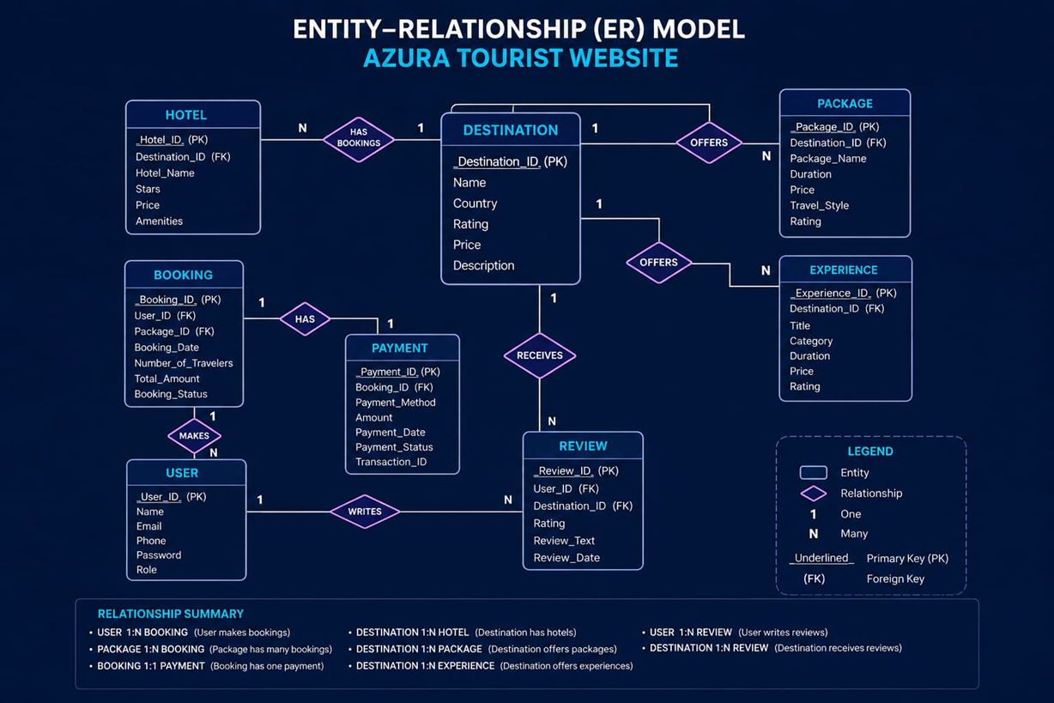
Entity–Relationship Model

Slide 5
Entities and Key Attributes
Entity Name | Primary Key | Important Attributes | Purpose
USER | User_ID | Name, Email, Phone, Password, Role | Stores registered accounts
DESTINATION | Destination_ID | Name, Country, Rating, Price, Description | Stores tourist location data
HOTEL | Hotel_ID | Destination_ID (FK), Hotel_Name, Stars, Price, Amenities | Stores accommodation details
PACKAGE | Package_ID | Destination_ID (FK), Package_Name, Duration, Price, Travel_Style, Rating | Stores tour packages
EXPERIENCE | Experience_ID | Destination_ID (FK), Title, Category, Duration, Price, Rating | Stores destination activities
BOOKING | Booking_ID | User_ID (FK), Package_ID (FK), Booking_Date, Travelers, Total_Amount, Status | Stores package reservations
PAYMENT | Payment_ID | Booking_ID (FK), Payment_Method, Amount, Date, Status, Transaction_ID | Stores transaction records
REVIEW | Review_ID | User_ID (FK), Destination_ID (FK), Rating, Review_Text, Review_Date | Stores user feedback

Slide 6
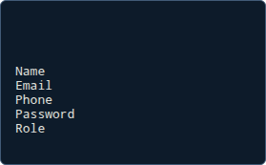
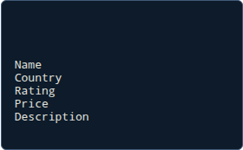
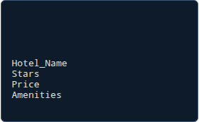
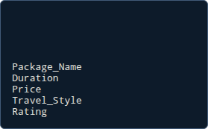

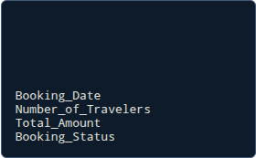
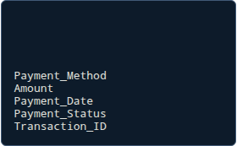

Relational Model Schemas
USER
DESTINATION
HOTEL
PACKAGE
User_ID (PK)
Destination_ID (PK)
Hotel_ID (PK)
Package_ID (PK)
Destination_ID (FK)
Destination_ID (FK)
EXPERIENCE
BOOKING
PAYMENT
REVIEW
Experience_ID (PK)
Booking_ID (PK)
Payment_ID (PK)
Review_ID (PK)
Destination_ID (FK)
User_ID (FK)
Booking_ID (FK)
User_ID (FK)
Package_ID (FK)
Destination_ID (FK)

Slide 7


Keys and Referential Integrity
Primary & Foreign Keys
Summary of Cardinalities
• Primary Key (PK): Uniquely identifies each tuple in a relation (e.g., User_ID, Destination_ID, Booking_ID). Ensures entity integrity.
• USER 1:N BOOKING (Makes)
• PACKAGE 1:N BOOKING (Booked Through)
• BOOKING 1:1 PAYMENT (Has)
• DESTINATION 1:N HOTEL (Has)
• DESTINATION 1:N PACKAGE (Offers)
• DESTINATION 1:N EXPERIENCE (Offers)
• USER 1:N REVIEW (Writes)
• DESTINATION 1:N REVIEW (Receives)
• Foreign Key (FK): Establishes relationship links across relations:
- BOOKING.User_ID → USER.User_ID
- BOOKING.Package_ID → PACKAGE.Package_ID
- PAYMENT.Booking_ID → BOOKING.Booking_ID
- HOTEL/PACKAGE/EXPERIENCE.Destination_ID → DESTINATION.Destination_ID

Slide 8


Conclusion & Future Scope
Conclusion
Future Scope
• Successfully translated real-world AZURA application requirements into a rigorous academic ER model and structured relational schemas.
• Flight & Transport Integration: Linking multi-modal transit services to bookings.
• Wishlist & Favorites: Persistent user-destination preference lists.
• Dynamic Availability: Real-time seat and room inventory tracking.
• Advanced Analytics: Reporting dashboards for booking trends and customer feedback.
• Established clean primary-foreign key dependencies to maintain referential integrity across users, destinations, packages, and bookings.
• Provided a robust, scalable backend foundation for complete tour management workflows.

